Slide 1
Transmission Control Protocol (TCP)
connection-oriented
stream data transfer
  data sent as an unstructured stream of bytes
reliability
  acknowledgements and timeouts; allows devices to deal with lost, delayed, duplicate, or misordered packets
efficient flow control
  when sending acknowledgements back to the source, the receiving TCP process indicates the highest sequence number it can receive without overflowing its internal buffers
full duplex operation
multiplexing

Slide 2
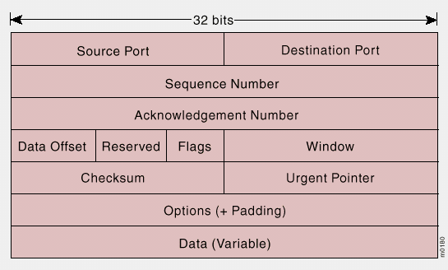
TCP Packet Format
Notes:
Source Port and Destination Port -- Identify points at which upper-layer source and destination processes receive TCP services.
Sequence Number -- Usually specifies the number assigned to the first byte of data in the current message. In the connection establishment phase, it can also be used to identify an initial sequence number to be used in an upcoming transmission.
Acknowledgment Number -- Contains the sequence number of the next byte of data the sender of the packet expects to receive.
Data Offset -- Indicates the number of 32-bit words in the TCP header.
Reserved -- Reserved for future use.
Flags -- Carries a variety of control information including the SYN and ACK bits used for connection establishment, and the FIN bit used for connection termination.
Window -- Specifies the size of the sender's receive window (that is, the buffer space available for incoming data).
Checksum -- Indicates whether the header was damaged in transit.
Urgent Pointer -- Points to the first urgent data byte in the packet.
Options -- Specifies various TCP options.
Data -- Contains upper-layer information.

Slide 3
Connection Establishment
Initiator
Receiver
Send SYN(seq=x)
Recv SYN(seq=x)
Recv SYN (seq=y)
ACK(x+1)
Send SYN(seq=y)
ACK(x+1)
Send ACK(y+1)
Recv ACK(y+1)

Slide 4
TCP Sliding Window
each packet includes both
  the acknowledgement number (which byte is expected next), and
  the window length (how much buffer space the packet sender has available)
this allows for efficient use of bandwidth

Slide 5
Application Layer Protocols
FTP. Moves files
SNMP. Provides a mechanism for managing networks
Telnet. Allows remote logins
NFS, XDR. Enables file sharing
RPC. Enables multiprocessing—allows a single program to run on multiple computers
X Windows. Allows graphical applications to run remotely
SMTP, POP, IMAP. Enable electronic mail
DNS. Enables distributed directory services
HTTP. Makes the World Wide Web work.

Slide 6
Overview
TCP mechanisms
Congestion control
  End-to-end (host based)
  Router-based

Slide 7
Introduction to TCP
Communication abstraction:
  Reliable
  Ordered
  Point-to-point
  Byte-stream
Protocol implemented entirely at the ends
  Assumes unreliable, non-sequenced delivery
  Fate sharing

Slide 8
TCP Reliability Mechanism
Sender
Receiver
data
1
2
ack
3
lost ack
2

Slide 9
TCP Header
Source port
Destination port
Sequence number
Flags:
SYN
FIN
RESET
PUSH
URG
ACK
Acknowledgement
Hdr len
0
Flags
Advertised window
Checksum
Urgent pointer
Options (variable)
Data

Slide 10
TCP Mechanisms
Connection establishment
Sequence number selection
Connection tear-down
Round-trip estimation
Window flow control

Slide 11
Connection Establishment
A and B must agree on initial sequence number selection:
Use 3-way handshake
A
B
A
B
Aseqn
SYN
SYN+ACK-A
Bseqn
ACK-B
ACK

Slide 12
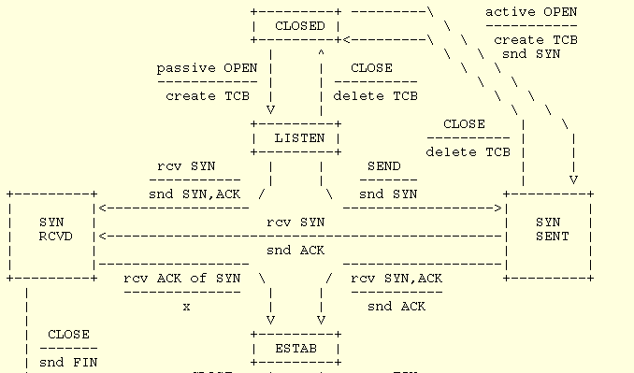
Connection Setup

Slide 13
Sequence Number Selection
Initial sequence number (ISN) selection
  Why not simply chose 0?
  Must avoid overlap with earlier incarnation
Requirements for ISN selection
  Must operate correctly
    Without synchronized clocks
    Despite node failures

Slide 14
ISN and Quiet Time
Use local clock to select ISN
  Clock wraparound must be greater than max segment lifetime (MSL)
Upon startup, cannot assign sequence numbers for MSL seconds
Can still have sequence number overlap
  If sequence number space not large enough for high-bandwidth connections

Slide 15
Connection Tear-down
Normal termination
  Allow unilateral close
  Avoid sequence number overlap
TCP must continue to receive data even after closing
  Cannot close connection immediately: what if a new connection restarts and uses same sequence number?

Slide 16
Tear-down Packet Exchange
Sender
Receiver
FIN
FIN-ACK
Data write
Data ack
FIN
FIN-ACK

Slide 17
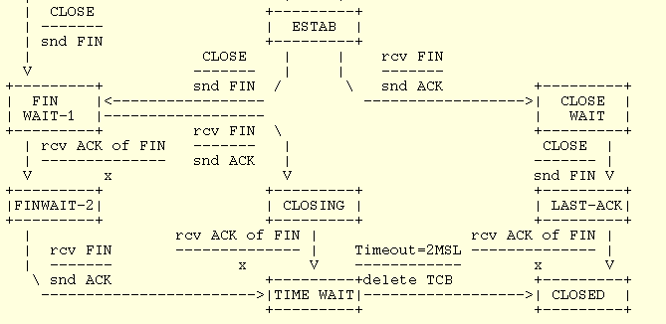
Connection Tear-down

Slide 18
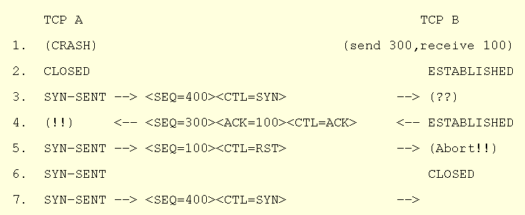
Detecting Half-open Connections

Slide 19
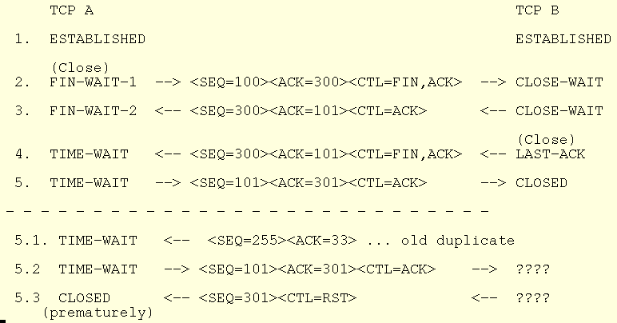
TIME-WAIT Assassination

Slide 20
Round-trip Time Estimation
Wait at least one RTT before retransmitting
Importance of accurate RTT estimators:
  Low RTT -> unneeded retransmissions
  High RTT -> poor throughput
RTT estimator must adapt to change in RTT
  But not too fast, or too slow!

Slide 21
Initial Round-trip Estimator
Round trip times exponentially averaged:
New RTT = α (old RTT) + (1 - α) (new sample)
Recommended value for α: 0.8 - 0.9
Retransmit timer set to β RTT, where β = 2
Every time timer expires, RTO exponentially backed-off

Slide 22
Retransmission Ambiguity
A
B
A
B
Original transmission
Original transmission
ACK
Sample
RTT
Sample
RTT
retransmission
retransmission
ACK

Slide 23
Karn’s Retransmission Timeout Estimator
Accounts for retransmission ambiguity
If a segment has been retransmitted:
  Don’t count RTT sample on ACKs for this segment
  Keep backed off time-out for next packet
  Reuse RTT estimate only after one successful transmission

Slide 24
Jacobson’s Retransmission Timeout Estimator
Key observation:
  Using β RTT for timeout doesn’t work
  At high loads round trip variance is high
Solution:
  If D denotes mean variation
  Timeout = RTT + 4D

Slide 25
Flow Control
Fast sender can overrun receiver:
  Packet loss, unnecessary retransmissions
Possible solutions:
  Sender transmits at pre-negotiated rate
  Sender limited to a window’s worth of unacknowledged data
Flow control different from congestion control

Slide 26
Window Flow Control: Send
window
Sent but not acked
Not yet sent
Sequence numbers
Next to be sent

Slide 27
Window Flow Control: Receive
Receive buffer
Acked but not
delivered to user
Not yet
acked
Sequence numbers
Gap
window

Slide 28
TCP Extensions
Implemented using TCP options
  Timestamp
  Protection from sequence number wraparound
  Large windows

Slide 29
Timestamp Extension
Used to improve timeout mechanism by more accurate measurement of RTT
When sending a packet, insert current timestamp into option
Receiver echoes timestamp in ACK

Slide 30
Protection From Wraparound
Wraparound time vs. Link speed:
    1.5mbps: 6.4 hours
    10mbps: 57 minutes
    45mbps: 13 minutes
    100mbps: 6 minutes
    622mbps: 55 seconds
    1.2gbps: 28 seconds
Use timestamp to distinguish sequence number wraparound

Slide 31
Large Windows
Apply scaling factor to advertised window
  Specifies how many bits window must be shifted to the left
Scaling factor exchanged during connection setup

